Slide 1
Detector Response Simulations
Matt Wilson
23/10/13

Slide 2
Introduction
Theory of Charge Induction Efficiency
Application in COMSOL
Example results from COMSOL
Combining with GEANT output
Example results of detector response
Next Tests and Information Needed
Information for reconstructions?

Slide 3
Charge Induction Efficiency
CIE = Charge Induced/Charge Generated.
Depends on:
Position of interaction relative to the pixel
Trapping of charge as it drifts through the detector – E, mobility, time, detector material & defects.
Diffusion of charge cloud as it drifts – Mobility, time.
Pixel Geometry – Schottky-Ramo, pixel size, thickness → weighting potential
Can solve equations for these factors to build up a map of CIE of every position in the detector
Q_{pix}= Q_{dep}(x,y,z,t=0) * CIE(x,y,z,t_{PreAmp})

Slide 4
Charge Induction Efficiency
T.H.Prettyman, NIM A, 428 (1999) 72-80 and 232-237
Shockley Ramo:
Charge on pixel k for x=electrons (n) or holes (p)
Weighting Potential of pixel k at the position of the charge carriers
Number density of charge carriers
q = charge of carrier
Velocity of charge carriers
Changing with time

Slide 5
Charge Induction Efficiency
For the example x=n → electrons: Number density changes with time as:
Generation or de-trapping
Mobility of electrons in detector material
Diffusion of electron cloud
Trapping of electrons
Drift of electrons in E field
$$D_{n}= \frac{μ_{n}k_{B}T}{q}$$
Lifetime of electrons in detector material

Slide 6
COMSOL
Need to calculate constants:
Geometry → Easy CAD tools to build and mesh for FE.
Electric Field → AC/DC – Electrostatics
Weighting Potential → AC/DC - Electrostatics
Calculate charge carrier concentration at all positions t=0 to t pre-amplifier, solving:
Drift & Diffusion = Transport of Species – Convection & Diffusion → Specify velocity and Diffusion Constant
Trapping → Add equations
Generation → Add equation
Combine to get CIE(t) map

Slide 7
Example Results
Electric Potential and Weighting Potential

Slide 8
Example Results
For 400µm thick Si – CIE quickly reaches maximum through pixel voxel in short time (<100ns).
-200V
50µm pixel pads
60µm pixel pitch
5x5 simulated
Central Pixel Solved

Slide 9
CIE per Pixel
Use CIE solved for one pixel and re-allocate to other pixels – doesn’t account for edge effects or defects.
After 1µs total CIE = 1
Charge sharing between pixels accounted for.

Slide 10
Detector Response
COMSOL
Geant
Load CIE(x,y,z)
Load E (x,y,z)
Extract Event – x,y,z,E
$Q(x,y,z)=q∗\frac{E [eV]}{W [\frac{eh pairs}{eV}]}$ W=3.62eV for Si
Extract CIE(x,y,z) for Pixel N and neighbour(s)
No
Is (x,y,z) in centre of pixel (CIE = 1)
$σ_{Q}=\sqrt{\frac{E}{W}}$
Yes
Extract CIE(x,y,z) for Pixel N
For signal shape t=0→t_{PreAmp}
$$Q_{Pixel}\left(t\right)=\int_{0}^{t_{PreAmp}}{CIE\left(t\right)∗Q }$$
Or for total signal t=t_{PreAmp}
$$Q_{Pixel}\left(t_{PreAmp}\right)=CIE\left(t_{PreAmp}\right)∗Q$$
Convert to V_{signal}(t_{PreAmp}) or *f(t)_{PreAmp}
Is V > Threshold
Yes
Store Voltage Output per pixel
No
Add ASIC noise
Information Lost
Reconstruct…

Slide 11
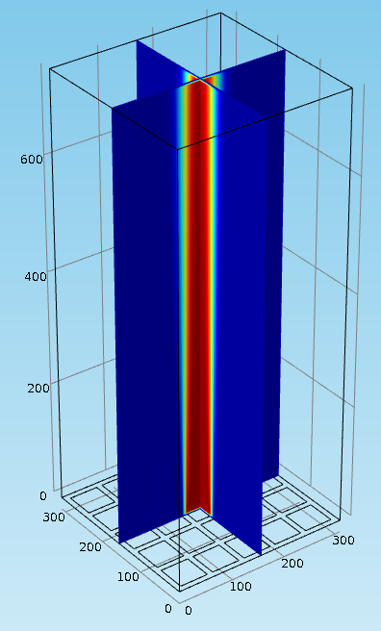
Example Results
Marc’s geometry (?) in GEANT simulations
60µm pitch pixels.
50µm pad.
10µm gap.
5cm
(0,0,0)
5cm
833*833 pixels = 700k pixels
3.3cm
0.75mm
t = 1µs unless otherwise stated.

Slide 12
e- track

Slide 13
Checking it works…
Saw that Total Q pixels < Q deposited from GEANT4.
Made many changes
Nullified noise in E → Q
Removed trapping and generation terms
Extended Pre-Amp time
Made threshold of event → 0
Ended up with Total Q pixels > Q deposited from GEANT4!

Slide 14
Meshing

Slide 15
Meshing
Concluded that I needed finer meshing and minimise discontinuities…
Had to move to a Unix workstation with more computing power
Had to buy a new license to do this
But anyone can log onto it and use it
Even external students if the paperwork is filled out!

Slide 16
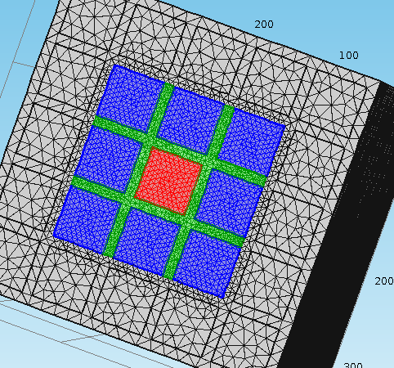
Meshing
Just started to test with finer mesh and no discontinuities.
Area | Min Mesh Size (µm) |  |  | Max Mesh Size (µm)
Mesh | 1 | 2 | 3 | 1 | 2 | 3
Grey | 1.1 | 1.1 | 0.15 | 26.3 | 26.3 | 15
Green & Blue | 0.15 | 0.1 | 0.1 | 15 | 10 | 5.0
Red | 0.1 | 0.1 | 0.1 | 5.0 | 5.0 | 5.0

Slide 17
Mesh

Slide 18
Meshing
Mesh 3 much better but still a loss of 2% in inter pixel region
Also some fluctuation at edge
Going to go to finer mesh and keep constant in inter-pixel region

Slide 19
Summary
Have got COMSOL solving CIE but some polishing and verification to be completed.
COMSOL on work station with option for external access.

Slide 20
Future – to discuss
Finer Mesh – Matt to complete tests
Solving output of the detector – what does Dan need?
Different geometry detectors – agree which to simulate in GAMOS and then solve CIE map.
Is solving CIE or CIE x E something that fits into Amina’s PhD?
Poster for UCL Pre-Clinical Meeting?
Approaching clinicians?
Funding options?

Slide 21
END

Slide 22
Energy Loss – with variation
%%%% |  |  | x | y | z | E | t
Scatter | 1 | 2 | -33.7324 | -10.7811 | 18.479 | 2.14983 | 0.130842
Scatter | 1 | 2 | -33.7327 | -10.7812 | 18.4788 | 2.60322 | 0.133246
Scatter | 1 | 2 | -33.733 | -10.7812 | 18.4788 | 3.63101 | 0.133248
%%%%
Scatter | 1 | 2 | -33.6823 | -0.23716 | -10.5362 | 44.5841 | 0.115776
%%%%
Scatter | 1 | 2 | -33.5533 | -14.343 | 1.59547 | 3.10819 | 0.12028
Scatter | 1 | 2 | -33.5717 | -14.3493 | 1.57323 | 13.4672 | 0.121843
Scatter | 1 | 2 | -33.5766 | -14.3517 | 1.5664 | 5.70247 | 0.121995
Scatter | 1 | 2 | -33.6033 | -14.371 | 1.53299 | 21.0317 | 0.122044
Scatter | 1 | 2 | -33.6052 | -14.373 | 1.53025 | 7.67459 | 0.122314
Scatter | 1 | 2 | -33.6058 | -14.3736 | 1.52926 | 1.82262 | 0.122338
Scatter | 1 | 2 | -33.6063 | -14.3739 | 1.52816 | 1.58223 | 0.122346
Scatter | 1 | 2 | -33.608 | -14.3744 | 1.52515 | 2.80993 | 0.122354
Scatter | 1 | 2 | -33.6082 | -14.3744 | 1.5248 | 1.26002 | 0.122377
Scatter | 1 | 2 | -33.6259 | -14.3762 | 1.49838 | 24.7648 | 0.122379
Scatter | 1 | 2 | -33.6313 | -14.3779 | 1.48812 | 13.7659 | 0.122588
Scatter | 1 | 2 | -33.6315 | -14.3782 | 1.48786 | 3.78164 | 0.122677
Scatter | 1 | 2 | -33.6375 | -14.3867 | 1.48268 | 29.0022 | 0.122682
Geant Output
8.383keV
44.584keV
129.739keV
Data with variation in the charge generation and a 5keV threshold for a valid event.
Difference of E_{in} to E_{out} up to 10%
Row Col # Energy(eV)
238 725 1 7.4868
413 241 2 43.706
177 441 5 34.208
178 441 5 10.193
177 442 5 58.927
177 443 5 5.2055
178 443 5 11.401
After CIE and Simulation
119.934keV

Slide 23
Energy Loss – no variation
%%%% |  |  | x | y | z | E | t
Scatter | 1 | 2 | -33.7324 | -10.7811 | 18.479 | 2.14983 | 0.130842
Scatter | 1 | 2 | -33.7327 | -10.7812 | 18.4788 | 2.60322 | 0.133246
Scatter | 1 | 2 | -33.733 | -10.7812 | 18.4788 | 3.63101 | 0.133248
%%%%
Scatter | 1 | 2 | -33.6823 | -0.23716 | -10.5362 | 44.5841 | 0.115776
%%%%
Scatter | 1 | 2 | -33.5533 | -14.343 | 1.59547 | 3.10819 | 0.12028
Scatter | 1 | 2 | -33.5717 | -14.3493 | 1.57323 | 13.4672 | 0.121843
Scatter | 1 | 2 | -33.5766 | -14.3517 | 1.5664 | 5.70247 | 0.121995
Scatter | 1 | 2 | -33.6033 | -14.371 | 1.53299 | 21.0317 | 0.122044
Scatter | 1 | 2 | -33.6052 | -14.373 | 1.53025 | 7.67459 | 0.122314
Scatter | 1 | 2 | -33.6058 | -14.3736 | 1.52926 | 1.82262 | 0.122338
Scatter | 1 | 2 | -33.6063 | -14.3739 | 1.52816 | 1.58223 | 0.122346
Scatter | 1 | 2 | -33.608 | -14.3744 | 1.52515 | 2.80993 | 0.122354
Scatter | 1 | 2 | -33.6082 | -14.3744 | 1.5248 | 1.26002 | 0.122377
Scatter | 1 | 2 | -33.6259 | -14.3762 | 1.49838 | 24.7648 | 0.122379
Scatter | 1 | 2 | -33.6313 | -14.3779 | 1.48812 | 13.7659 | 0.122588
Scatter | 1 | 2 | -33.6315 | -14.3782 | 1.48786 | 3.78164 | 0.122677
Scatter | 1 | 2 | -33.6375 | -14.3867 | 1.48268 | 29.0022 | 0.122682
8.383keV
44.584keV
129.739keV
No variation in charge generation…BUT there is still an “ASIC” threshold of 5keV if data is saved
Row Col # Energy(eV)
238 725 1 7.5331
413 241 2 43.671
177 441 5 34.326
178 441 5 10.202
177 442 5 58.885
177 443 5 5.1527
178 443 5 11.445
178 444 5 5.014
Slightly closer E_{in} to E_{out} but still →~10%
125.025keV

Slide 24
Energy Loss – Threshold
Example – Event 1
Charge sharing on the neighbour with one pixel having < Threshold is the major cause of the energy loss.
This effect will get worse with smaller pixels and thicker detectors → need to complete simulations to quantify.
Shows importance of an ASIC having low energy operating range.
Too low – not saved
Saved

Slide 25
Energy Loss – Lower Threshold
Energy threshold → <1keV all same
Row Col # Energy(eV)
237 725 1 0.8419
238 725 1 7.5331
413 241 2 43.671
177 441 5 34.326
178 441 5 10.202
177 442 5 58.885
177 443 5 5.1527
178 443 5 11.445
178 444 5 5.014
0.009keV lower
0.913keV lower
125.025keV
4.749keV lower
Lowering threshold only recovers correct energy in some events → there is still a shortfall in the induced energy → is CIE correct? Is Collection time (1us) long enough in this case? Is it from trapping added to CIE?

Slide 26
Longer Collection Time
Same with t=2us.

Slide 27
Remove Trapping and Generation
Make lifetimes longer to negate trapping
Small
change

Slide 28
Overlap of CIE
CIE overlap into next pixel → added to code - ~2% error

Slide 29
Finer Mesh in COMSOL

Slide 30
Finer Mesh in COMSOL

